Slide 1
SIT216 User Centred Design
Topic 5
Interaction Design

Slide 2
Last Topic...
Interface Design
Nature of design
Four pillars
User Centred Design
User characteristics
Functionality
Tasks
Site characteristics
Standards
Guidelines
Design methodologies
Rapid Contextual Design, Ethnographic Observation, Participatory Design, Agile Usability Engineering

Slide 3
This Topic
Interaction Design
Approaches to Interaction Design
Paradigms
Styles

Slide 4
Interaction
1

Slide 5

Interaction
Forming the goal
Forming the intention
Evaluating the outcome
Specifying the action
Interpreting the state of the world
The User
Executing the action
Perceiving the state of the world
The World

Slide 6
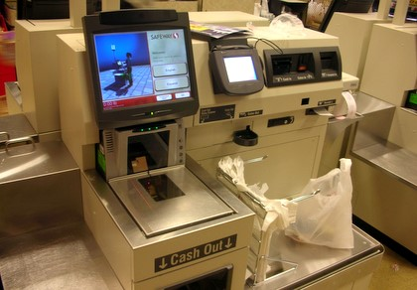
Activity - Interaction
Think of a goal you have when using a hardware device or software program/app.
Describe the interaction steps you are required to perform
Describe how the device/program/app responds to you and how you interpret and perceive (see) what is happening
For example – using a:
self-service machine
specific app
store directory in a shopping mall/centre

Slide 7
Interaction
“Interactivity in a computer product means that the user, not the designer, controls the sequence, the pace, and most importantly, what to look at and what to ignore.” (Kristof & Satran, 1995)

Slide 8
Concerns
How can an interactive system be developed to ensure its usability?
How can the usability of an interactive system be demonstrated or measured?

Slide 9
Approaches
Two approaches exist:
Use of paradigms: successful systems serve as models for new systems
Use of principles: systems are derived from theoretical concepts

Slide 10
Approaches
Assumptions:
modern interactive systems are more usable than those built in the past
there is considerable room for improvement
usability comes from the use of technology to augment the power of the human
paradigms depend on technological advances
principles depend on understanding the human element.

Slide 11
Interaction Paradigms
2

Slide 12
Paradigms for Interaction
Time-sharing
1940s and 50s: explosive technological growth
https://bizfluent.com/info-8167994-major-inventions-1940s.html
https://www.timetoast.com/timelines/technology-in-the-1950s
1960s: time-sharing systems to channel the power
Move from batch to interactive systems
Interaction now, was not a linear, preplanned activity directed towards the computer.
Video – 1963 Timesharing: A Solution to Computer Bottlenecks: https://youtu.be/Q07PhW5sCEk

Slide 13
Paradigms for Interaction
Video-display units
a medium other than paper for displaying information
1962 - Sutherland’s Sketchpad
Something other than data processing
The computer was made to speak a human language rather than the other way round
Demonstrated how a technological advance can alter the paradigm for interaction.

Slide 14
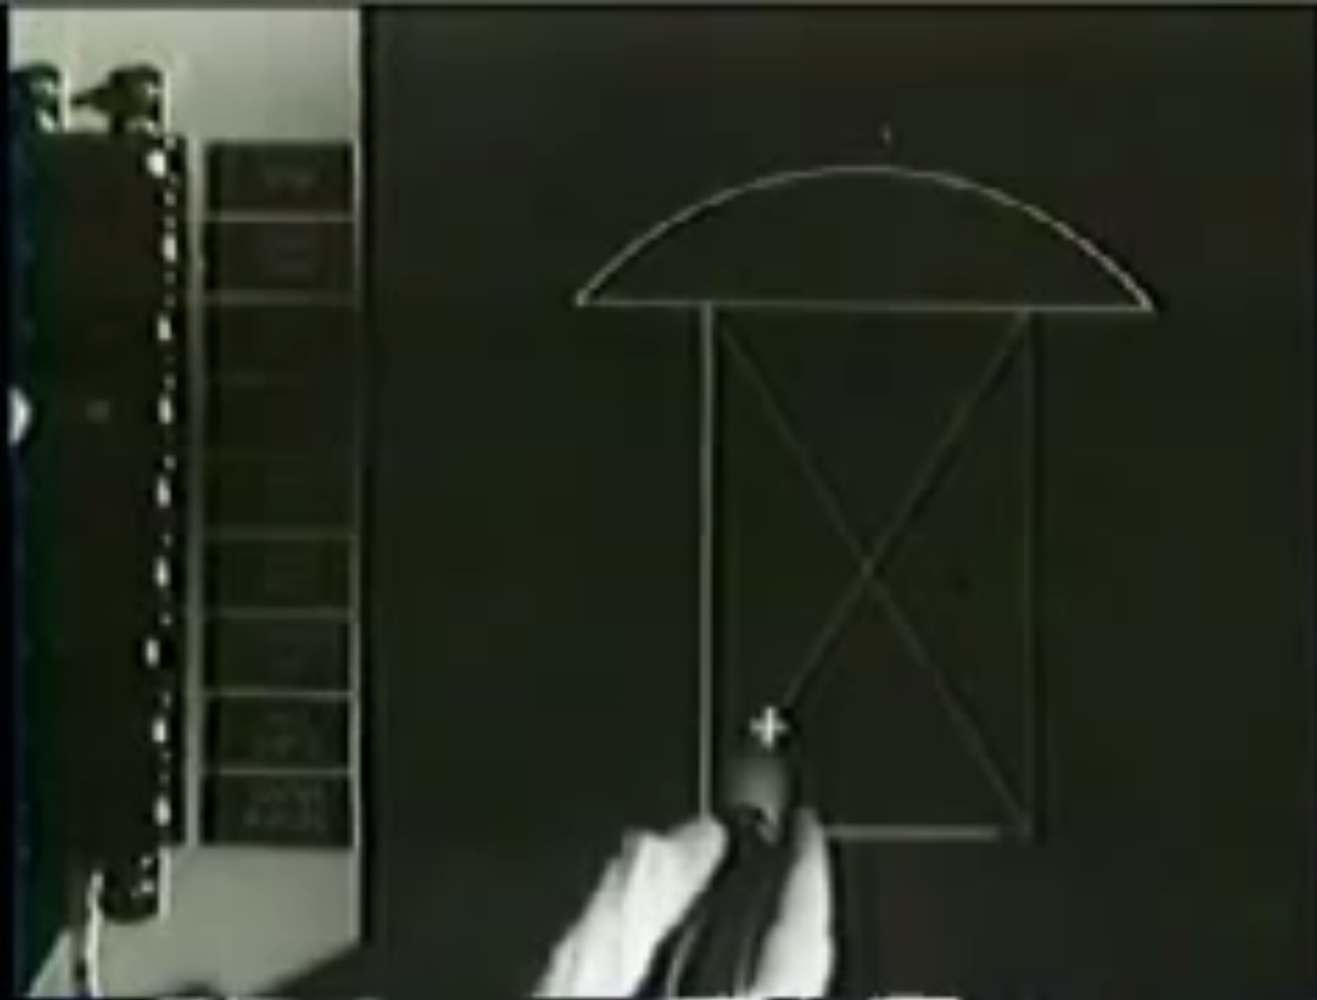
Paradigms for Interaction

Slide 15
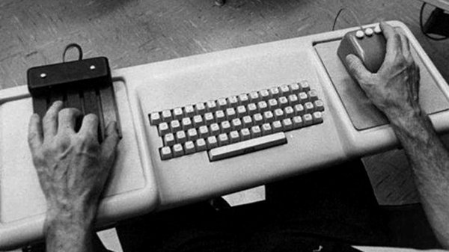
Paradigms for Interaction
Programming toolkits
Englebart (Stanford Research Institute 1962): increasing one’s capabilities by augmenting one’s intellect
word processing
the mouse (late 70s)
Toolkits: provide building blocks to produce complex interactive systems.
Source: http://www.tested.com/tech/3630-the-mother-of-all-demos-revolutionized-computing-interfaces-in-1968-video/

Slide 16
Paradigms for Interaction
Personal computing:
A system is more powerful as it becomes easier to use
Computing in small, powerful machines dedicated to the individual
PARC (Palo Alto Research Center) - research and development organisation: the birthplace of windowing systems (then Xerox PARC)
Office Alto commercial from Xerox
Xerox Star
The Xerox Thieves: Steve Jobs & Bill Gates

Slide 17
Paradigms for Interaction
Windowing Systems WIMPs – https://techterms.com/definition/wimp
What are included in these systems (hint: look at Windows/macOS) – W? I? M? P?
Windows
Icons
Menus
Pointers
At last, humans can pursue more than one task at a time
Partitions dialogues into physically distinct regions to maintain context and threads.

Slide 18
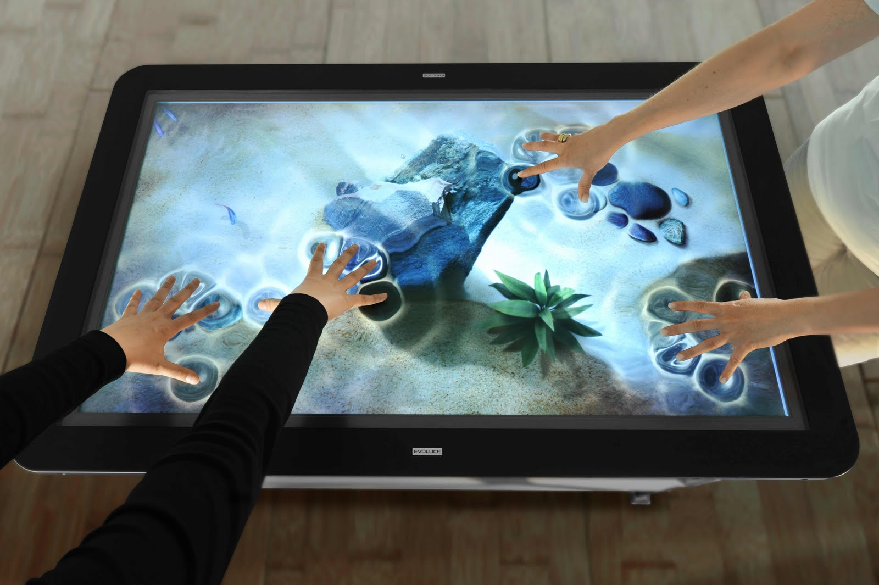
Paradigms for Interaction
Direct Manipulation (Ben Shneiderman):
visibility of objects
incremental action and rapid feedback
reversibility encourages exploration
syntactic correctness: every user action is a legal operation
replace language with action, e.g.
move files with drag and drop rather than commands.
Example – interactive wall
…others?

Slide 19
Paradigms for Interaction
Action versus Language
Direct Manipulation: interface models the underlying system
the user learns the interface, not the system; actions not understanding
Language (syntax/commands): interface does not model the underlying system
user must understand the underlying system for the system to respond
interface acts as an intelligent agent
Examples:
3D virtual objects
Gaze-touch

Slide 20
Paradigms for Interaction
Before we work on an activity considering two of these current paradigms…
Can you imagine 1 or 2 future paradigms (or those currently ‘bleeding edge’) that you expect will be recognised as another shift? Why and how would this happen?
Notes:
2 minutes – quick brainstorm on gaps and future paradigms – Geelong and Cloud comments via live chat
Brain Machine Interface (BMI) or Brain Computer Interface (BCI) – EEG and haptics... not quite Matrix level yet – Institute of Intelligence Systems Research & Innovation (ISIRI - WP)
https://res.cloudinary.com/engineering-com/image/upload/w_640,h_640,c_limit,q_auto,f_auto/DSC_6124-500px_zbkzgc.jpg

Slide 21
Activity - Paradigms for Interaction
With the students around you, discuss your experiences with windowing systems and direct manipulation interaction paradigms.
What systems/devices have you used?
What paradigm/s do they belong to?
How easy are they to use?
Did it take a long time (and repeated attempts) to understand?
What paradigm/s (like windowing systems or direct manipulation) do you prefer? Why?
What hardware/software is required for the windowing systems and direct manipulation paradigms?

Slide 22
Interaction styles
3

Slide 23
Interaction Styles
Interaction is the dialogue between the user and the computer
Common styles include:
Command Lines Interfaces (CLIs)
Menus
Question/Answer
Form fill-ins
GUIs
NUIs
Natural Language

Slide 24

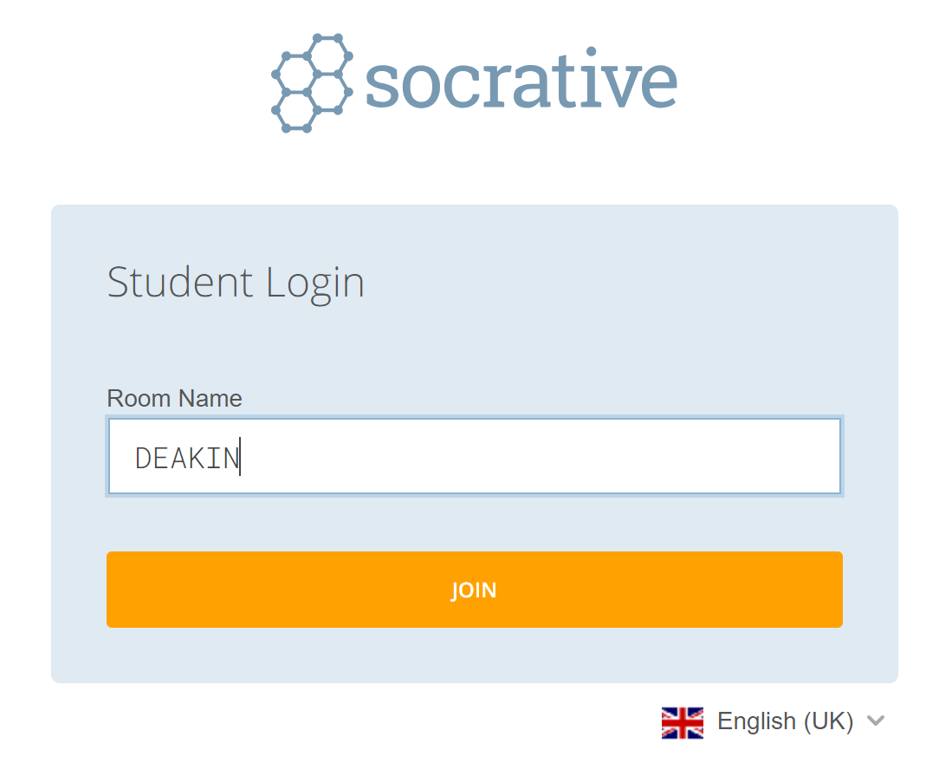
Activity Preparation - Interaction Styles
Go to https://www.socrative.com/ on your phone or laptop
Click on ‘Student Login’:
Type ‘Deakin’ in the ‘Room Name’ field, and then choose ‘Join’:
There is a quiz to find out about your experiences with different interaction styles.

Slide 25
Activity - Command-line Interfaces
On Socratives in the ‘Deakin’ room you just joined:
Add an example of a system/name of an application/product that you have seen (or used) that includes a command-line interface
I will review your responses after presenting an overview of this interaction style… go!
Notes:
No timer for these activities. I will put the question up, and then explain the concept. Students can respond over that time.

Slide 26
Command-line Interfaces
Expressing instructions to the computer directly – function keys, single characters, short abbreviations, words
Suitable for repetitive tasks
High memory load placed on users
Considerable training required
Examples: MS-DOS, UNIX

Slide 27
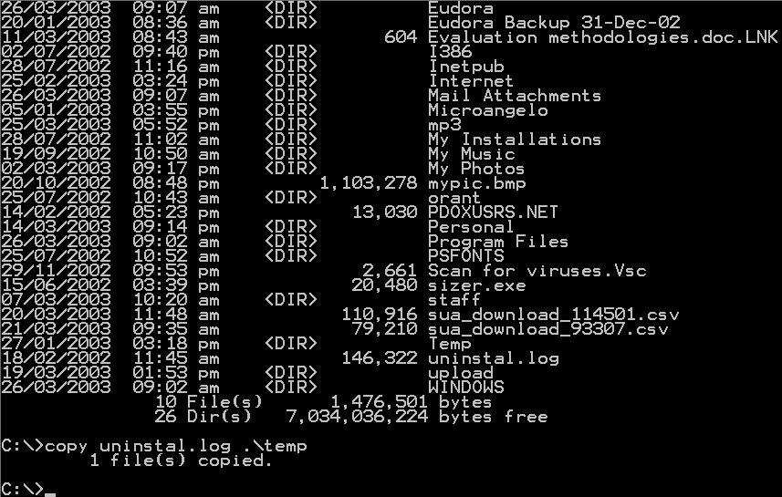
Command-line Interfaces

Slide 28
Activity - Menus
Return to the quiz on Socratives available in the ‘Deakin’ room
Add an example of a system/name of an application/product that you have seen (or used) that includes a menu
I will review your responses after presenting an overview of this interaction style… go!

Slide 29
Menus
Set of options displayed, user selects appropriate option
All available options visible so system concentrates on recognition rather than recall
Hierarchical, hence groupings are important
Available in text-based and GUI based systems.

Slide 30
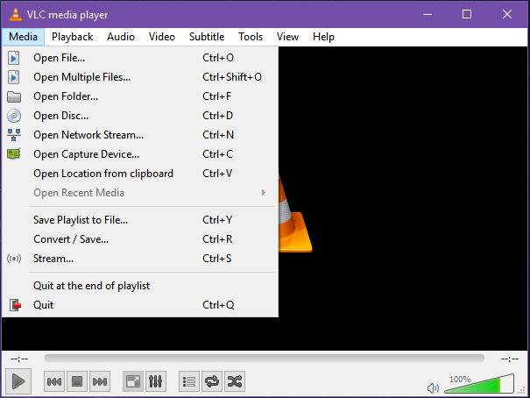
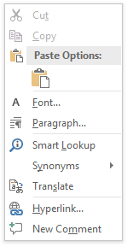
Menus

Slide 31
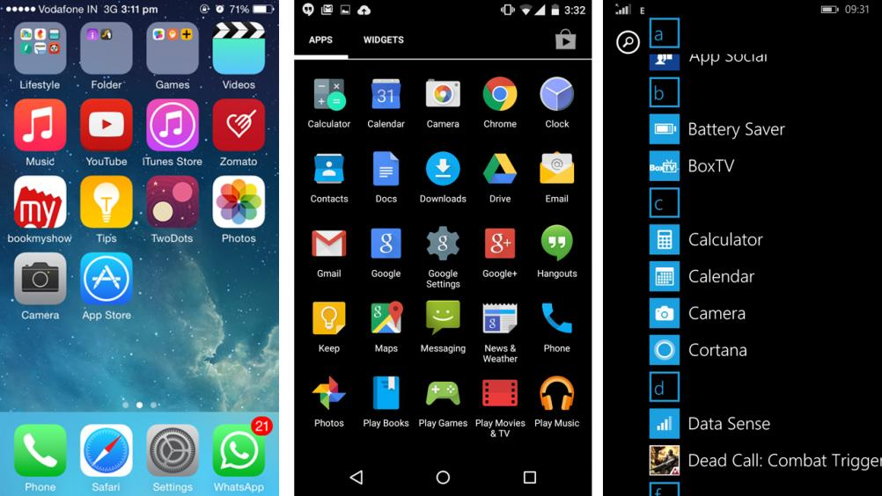
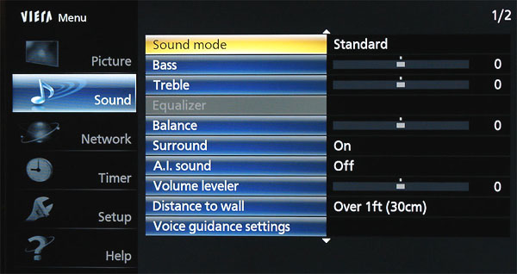
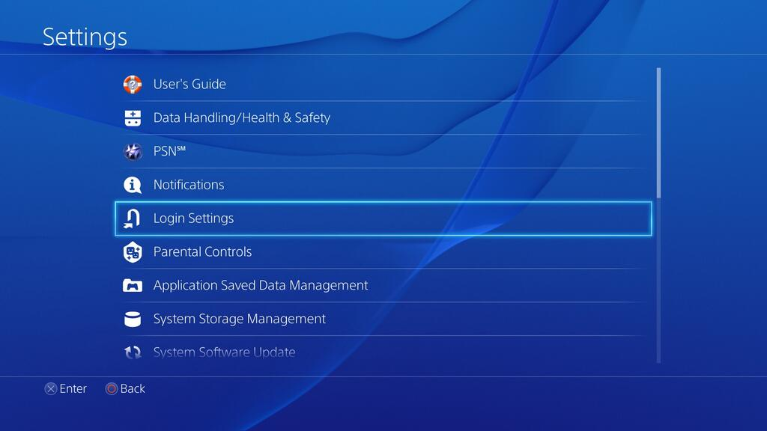
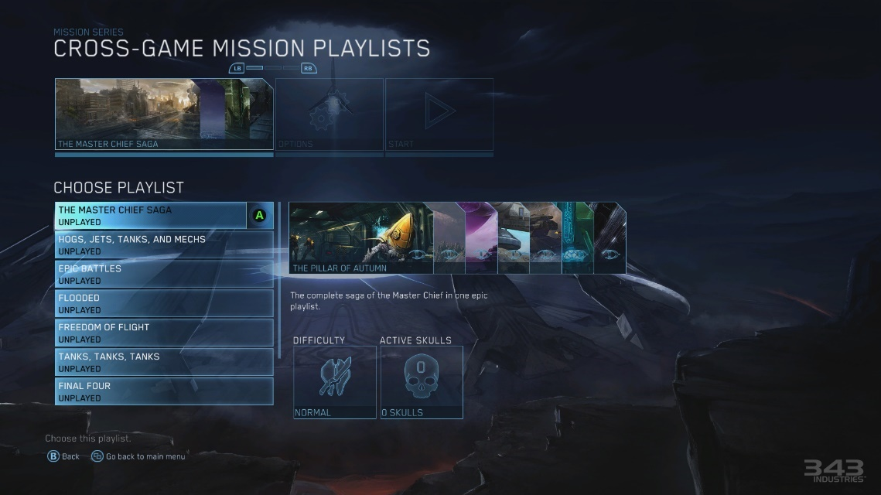
Menus

Slide 32
Menus
Users are prompted but they must remember the structure.
Users often have to travel forwards and backwards down trails to discover possible actions.
There is considerable effort required to create a mental model of the structure.
The models of different menus can merge together and therefore create confusion.

Slide 33
Activity – Question/Answer
Return to the quiz on Socratives available in the ‘Deakin’ room
Add an example of a system/name of an application/product that you have seen (or used) that requires the user to follow a question/answer interaction style (conversation)
I will review your responses after presenting an overview of this interaction style… go!

Slide 34
Question/Answer
User is led through a series of questions
A very linear and highly structured interface – restricted functionality
User must have an answer to proceed
Useful when a user must be guided through and intricate series of steps

Slide 35
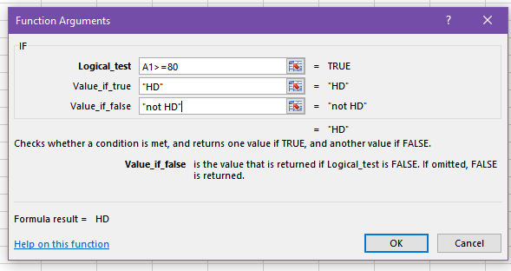
Question/Answer

Slide 36
Activity – Form Fill-in
Return to the quiz on Socratives available in the ‘Deakin’ room
Add an example of a system/name of an application/product that you have seen (or used) that requires the user to complete a form fill-in.
I will review your responses after presenting an overview of this interaction style… go!

Slide 37
Form Fill-in
Primarily used for data entry
Requires good design as large amounts of data need to be displayed on the screen
Screen must match the workflow of the user
User must be able to re-visit entry fields
Selection rather than keying?

Slide 38
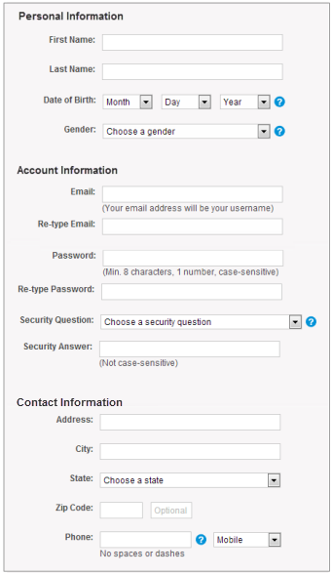
Form Fill-in

Slide 39
Activity – GUIs
Return to the quiz on Socratives available in the ‘Deakin’ room
Add an example of a system/name of an application/product that you have seen (or used) that has a Graphical User Interface (GUI).
I will review your responses after presenting an overview of this interaction style… go!

Slide 40
GUIs
Based on the WIMP interface
Windows
Icons
Menus
Pointers
Widgets: the set of interface elements available to the designer

Slide 41
Activity – NUIs
Return to the quiz on Socratives available in the ‘Deakin’ room
Add an example of a system/name of an application/product that you have seen (or used) that has a Natural User Interface (NUI).
I will review your responses after presenting an overview of this interaction style… go!

Slide 42
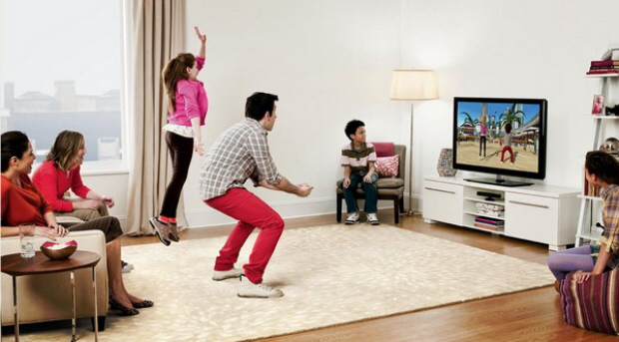
NUIs
Natural interaction methods
Touch
Gestures
Speech
Sight
The interaction is ‘invisible’ and systems can learn behaviours/expectations

Slide 43

NUIs

Slide 44

NUIs

Slide 45
Activity – Natural Language
Return to the quiz on Socratives available in the ‘Deakin’ room
Add an example of a system/name of an application/product that you have seen (or used) that requires the user to interact with it using only natural language.
I will review your responses after presenting an overview of this interaction style… go!

Slide 46
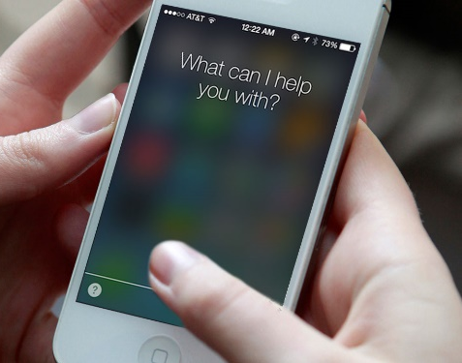
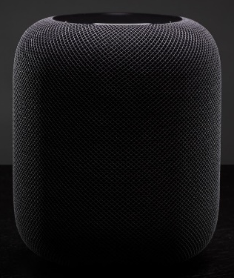
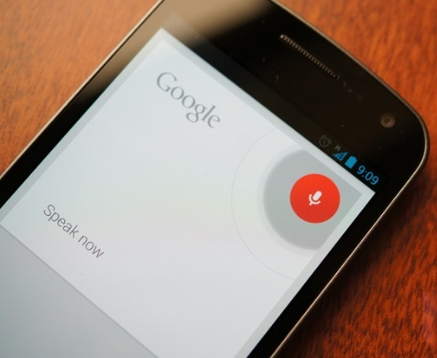
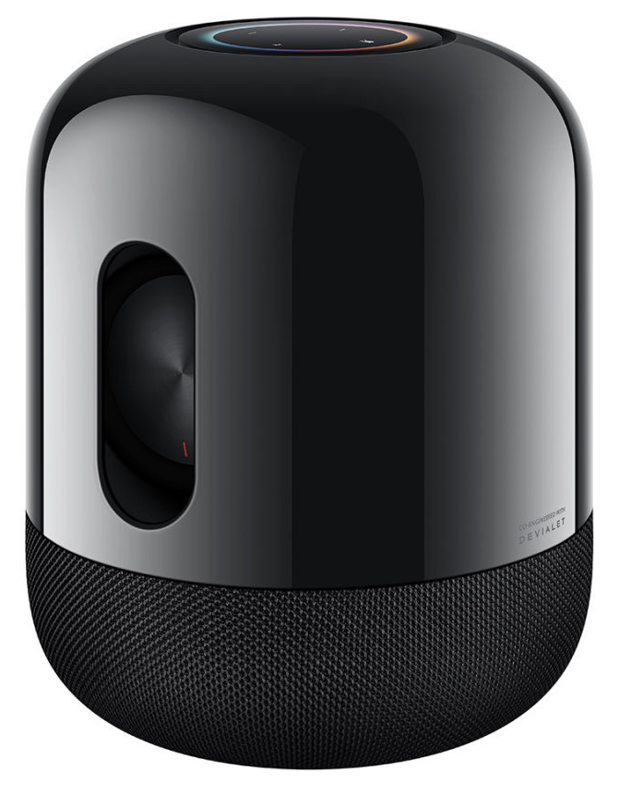
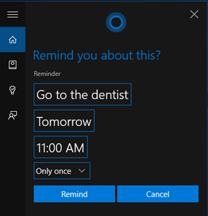
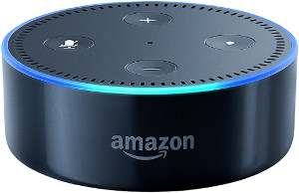
Natural Language
The “ideal” interface?
Speech recognition or typing
Problems:
Ambiguities
Spelling and grammar
Do what I mean……….please
Will it ever work?

Slide 47
Activity – Interaction Styles
In groups of 2-3, you will investigate both Prezi (http://prezi.com/) and PPT (PowerPoint).
Both tools can be used in the presentation and delivery of information, however, their interaction styles vary.
You do not need to have a Prezi account. Instead access examples from the Prezi Gallery at https://prezi.com/gallery/ or by watching videos elsewhere.
Consider a user’s goal is to create a 3 slide presentation.

Slide 48
Activity – Interaction Styles
To help determine Prezi and PowerPoint’s functionality, investigate both applications in relation to:
Creating new, or additional text/images (formatting), and saving;
Playing a presentation
Then consider these questions and record your findings:
What are the key differences between Prezi and PPT (PowerPoint)?
List the advantages/disadvantages of both packages.
Discuss your answers with another group. Note areas where you agree and disagree with each other. Also consider, and evaluate any possible solutions to help fix any weaknesses of either package.
Consider, and evaluate the usability (visibility and affordance) for both Prezi and PPT (PowerPoint).

Slide 49
Interaction Frameworks
Why are some interfaces harder to use than others?
There is a breakdown in the communication of the designer’s mental model to the user
The user’s understanding of tasks is different to the designer’s
The user’s reaction to changes in the system state is different to that expected
Designers have not considered user views.

Slide 50
Usability Principles
4

Slide 51
Usability =
“a broad concept that refers to how easy it is for users to learn a system, how efficiently they can use it once they have learned to use it, and how pleasant it is to use”
Nielsen & Mack (1994:3)

Slide 52
Guidelines for Usability
We are designing for USE
Audience-centred
WHO are you designing for?
WHAT are you communicating?
WHICH media are you using?

Slide 53
Usability
It isn’t difficult to get it right!
Why do designers still insist on frustrating the users of their products?
Why are users still purchasing products that fail to utilise good design principles?
Often requires trade-offs in aesthetics
May cost more (but not always)

Slide 54
Activity - Usability
You have heard some of my thoughts on usability and User Centred Design so far throughout this course.
Now with a small group of students around you, it is your turn to discuss and think about these questions:
Why are some websites/products/apps/objects, etc not usable and cause users to become frustrated?
Why do we (humans/users/consumers) purchase products that do not use good design principles (possibly obvious ones that can be seen/observed in a shop or in pictures online on Taobao, Alibaba, etc)?
Record your own thoughts/opinions/stories. You may then talk to other groups or me for feedback/comments.

Slide 55
Principles of Design for Usability
Provide a good conceptual model
Make things visible so that intuitive understanding can occur with ease
Take advantage of natural mapping
Provide feedback

Slide 56
The attributes that contribute to usability
The ease and speed with which a user can learn to use a system/product – “learnability”
The ease and efficiency of use once the initial learning period is over – “efficiency”
The myriad of ways in which the user and the system are enabled to exchange information – “flexibility”
The level of satisfaction derived from the use of the system – “satisfaction”

Slide 57
The attributes that contribute to usability
Users should not make many errors using the system, and if they do, it should be able to easily recover from them – “robustness”
The casual/novice user should be able to return to the system without having to relearn everything – “memorability”

Slide 58
LEARNABILITY
5

Slide 59
Factors affecting Learnability
Consistency in input and output required
Familiarity – the extent to which the user can apply known experience to the use of the new system/product – mapping, metaphors, affordance

Slide 60
Factors affecting Learnability
Predictability – user’s past experience of the system (the interaction history) determines future interactions
Generalisability – the extent to which the user can apply knowledge of an interaction across applications to other similar situations

Slide 61
….can be measured by:
The frequency of error messages (and particular types of error messages!)
The frequency of use of the online help system
The number of times a user sought assistance (from a myriad of sources)
….and a seemingly infinite and definitely unmeasurable multitude of other ways!

Slide 62
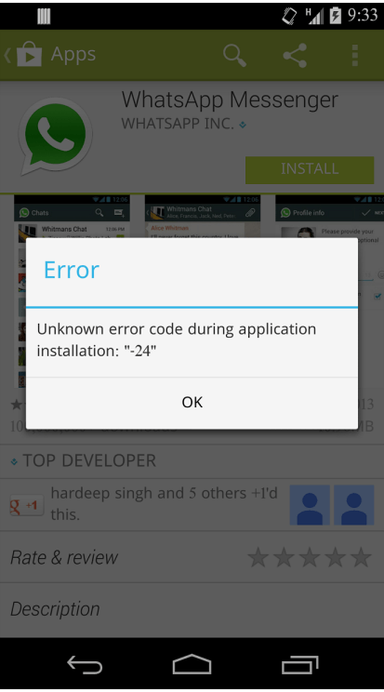
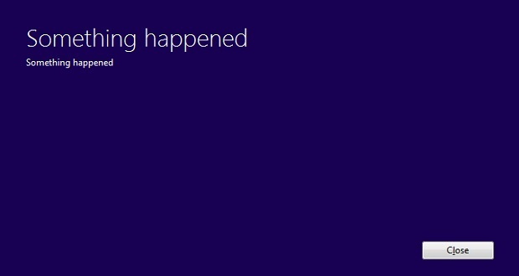
Examples

Slide 63
Efficiency
6

Slide 64
Factors affecting Efficiency
Performance time – how long does it take the user to perform tasks
Completion – the success or failure to complete a task
Retrieval time – how long does the user take to find information
Frequency of access to online help system

Slide 65
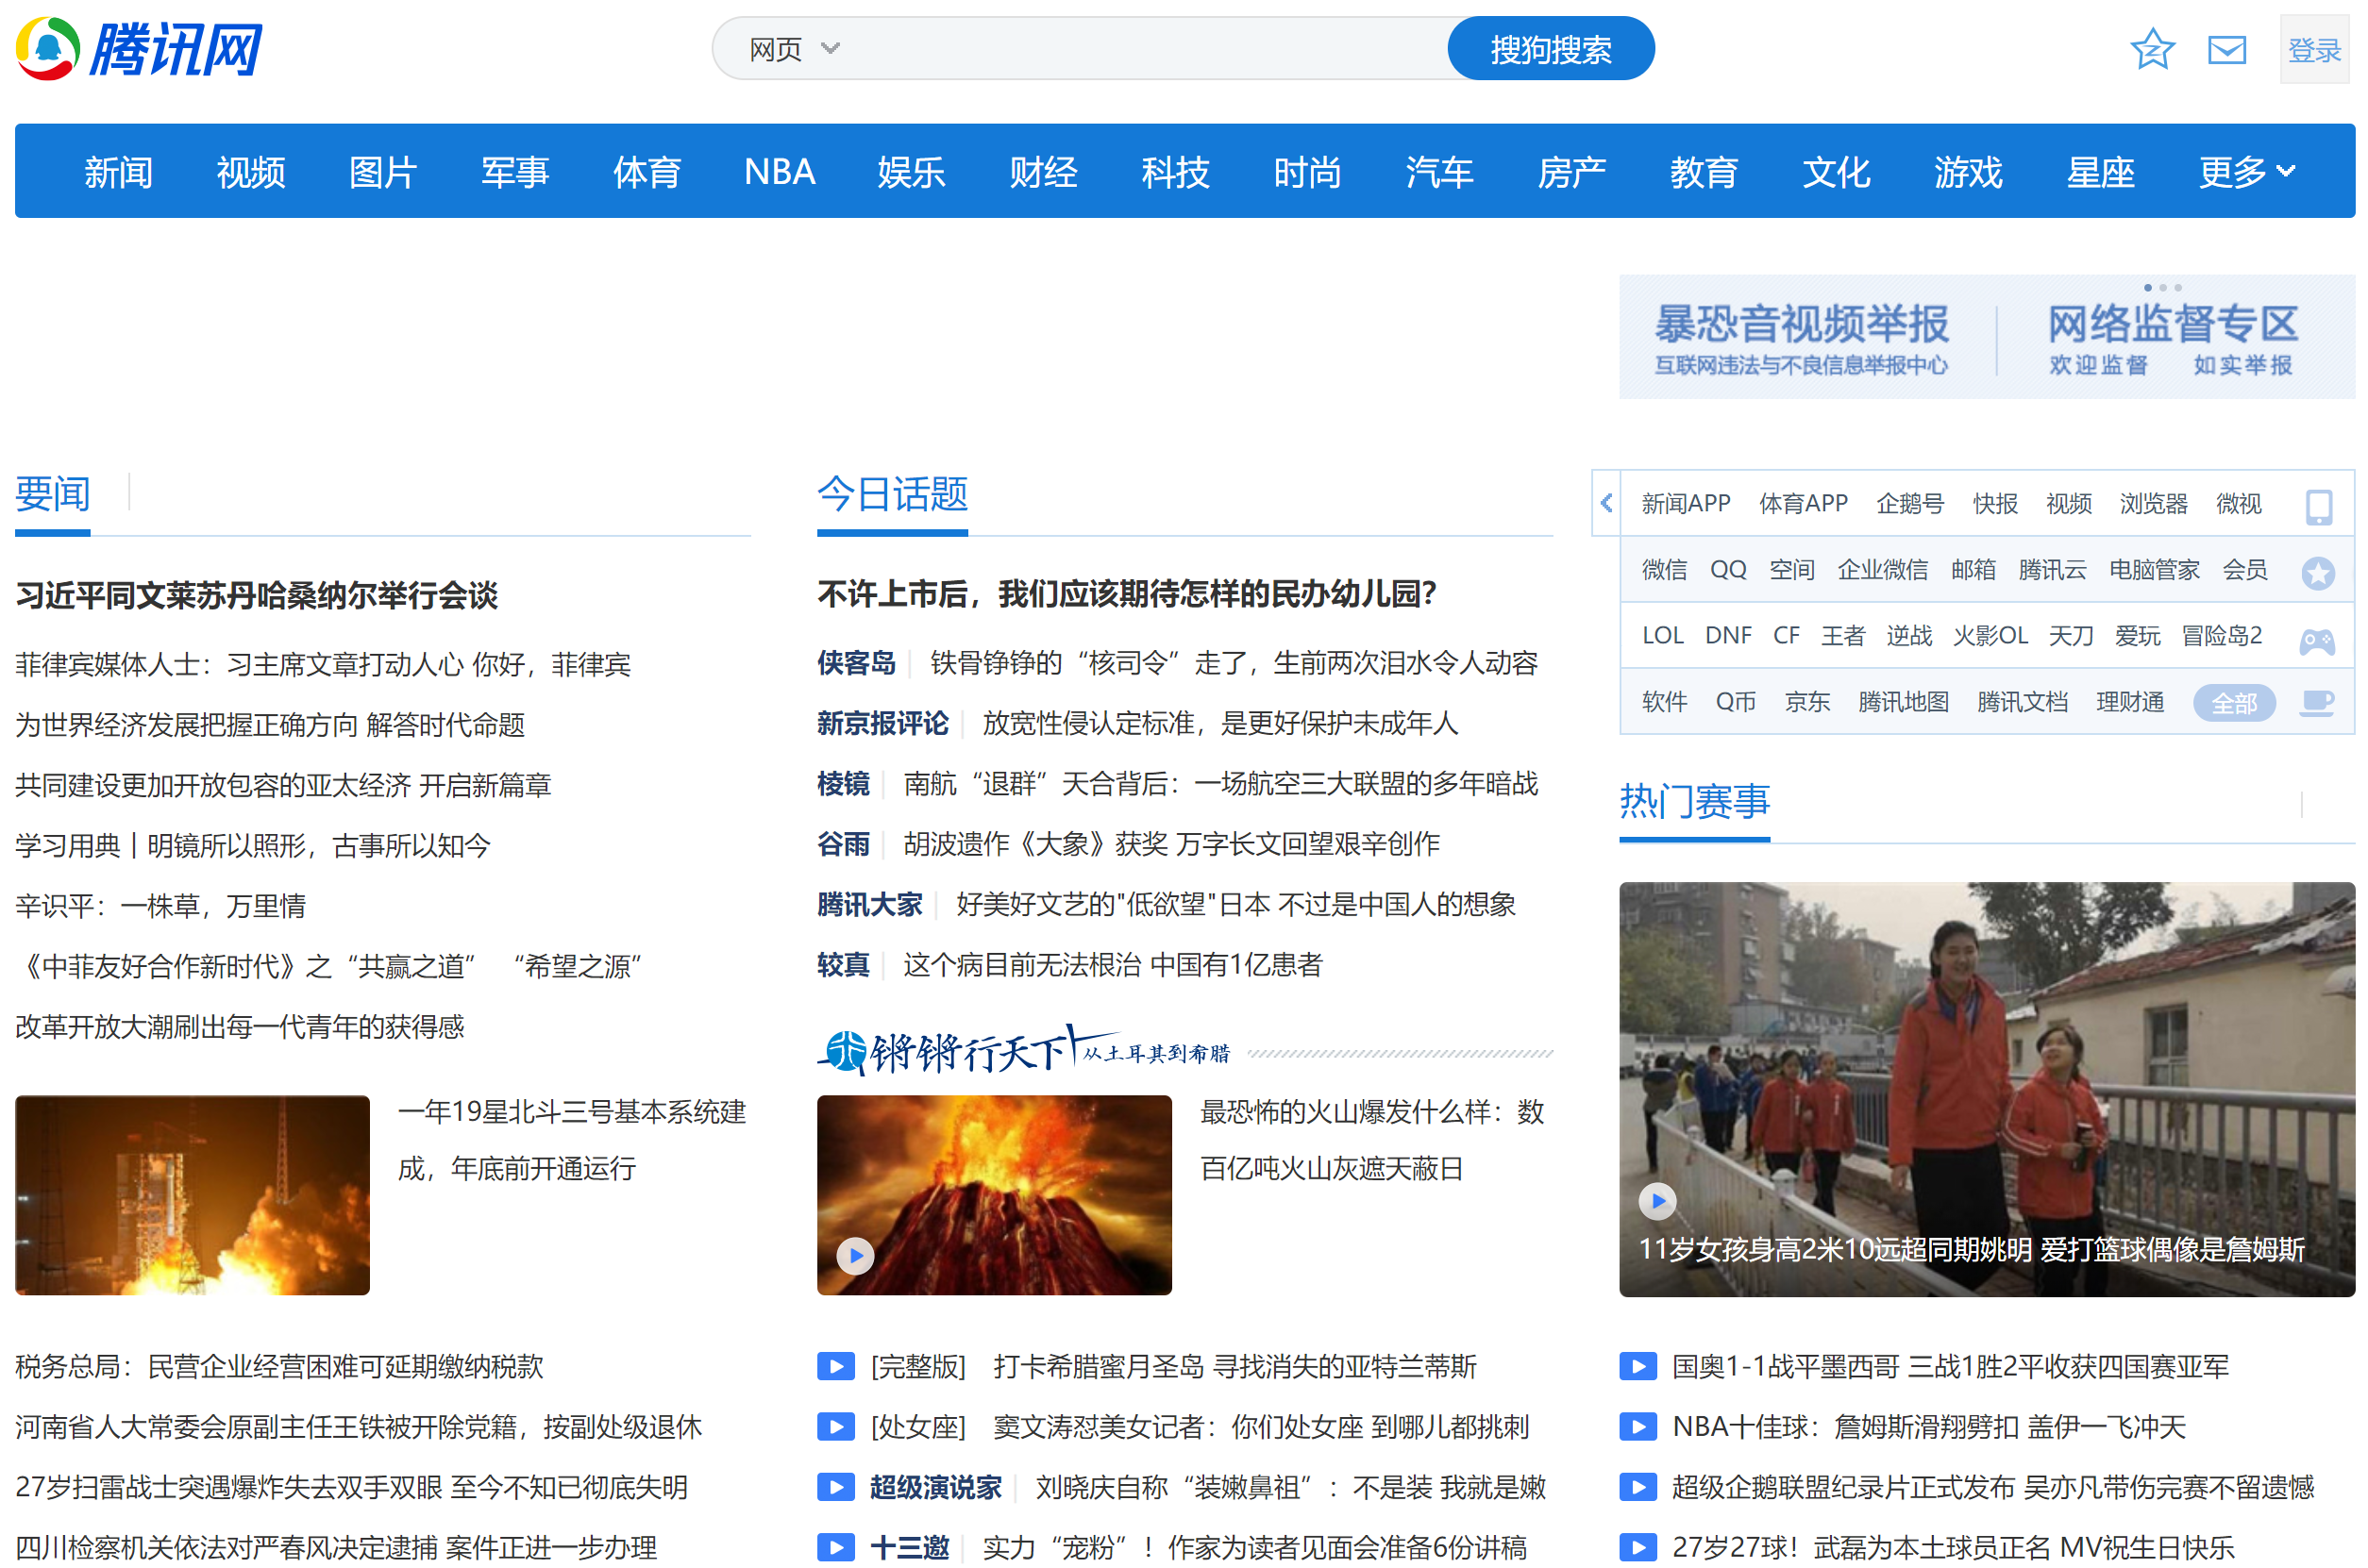
Example

Slide 66
Flexibility
7

Slide 67
Factors affecting Flexibility
Initiative – allowing for user initiative in the dialogue between user and system
Multi-threading – allows for interaction to support more than one task at a time
simultaneous communication of information that relates to separate tasks
without multithreading the system becomes modal

Slide 68
Factors affecting Flexibility
Example: while browsing websites with multiple tabs, you hear a “ding” which alerts you to a new instant message
Substitution – writing a document allows the user to choose the form (margins etc) which best suit the moment

Slide 69
Factors affecting Flexibility
Customisation – modification of the interface by either the user or the system
automatic modification of the system premised on its knowledge of the user
user-initiated = adaptability
system-initiated = adaptivity

Slide 70
Factors affecting Flexibility
Task migration – can the user or the system pass control over to the other
Example 1
a spellchecker, user needs to have discretionary power to override the spellchecker decision
Example 2
autocorrect, user can pass control to the system to correct errors

Slide 71
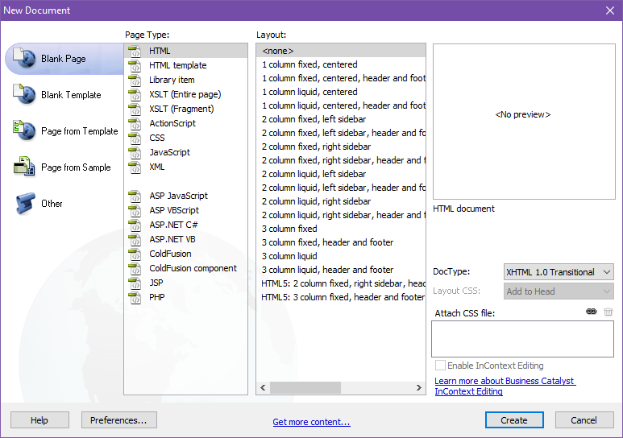
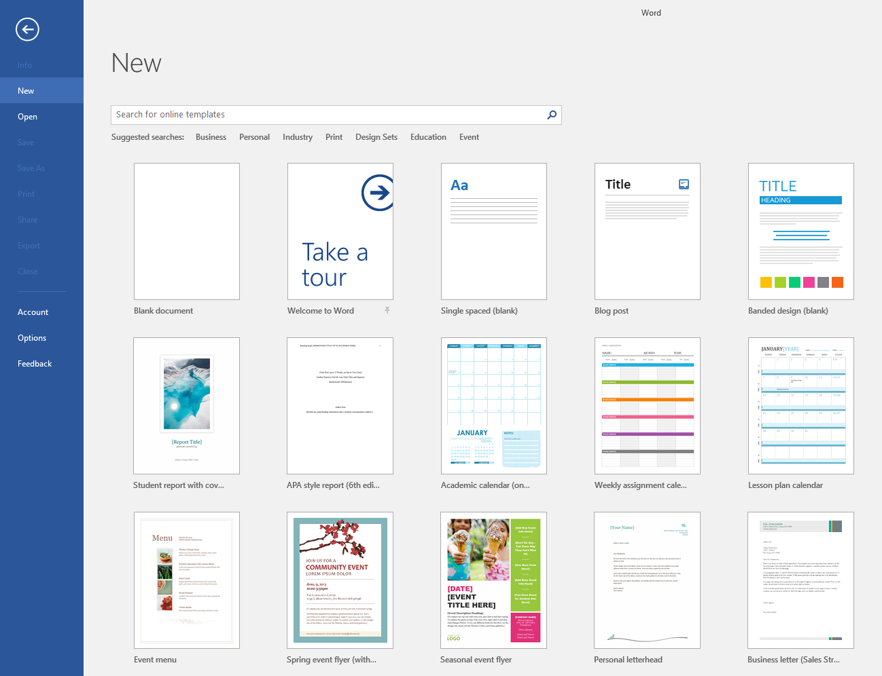
Examples

Slide 72
Examples

Slide 73
SATISFACTION
5

Slide 74
Factors affecting Satisfaction
Ignoring usability – having users/humans being unable to work quickly and effortlessly with systems
Misunderstanding users – inflexible (limited interactivity), tasks/goals, aesthetics
Disregarding emotions – focus only on ‘traditional’ values of speed and performance (efficiency and effectiveness)
Invalid/incomplete data – preventing or delaying goal attainment
Lack of trust – in the system/app/service and the consequential desire to find alternatives

Slide 75
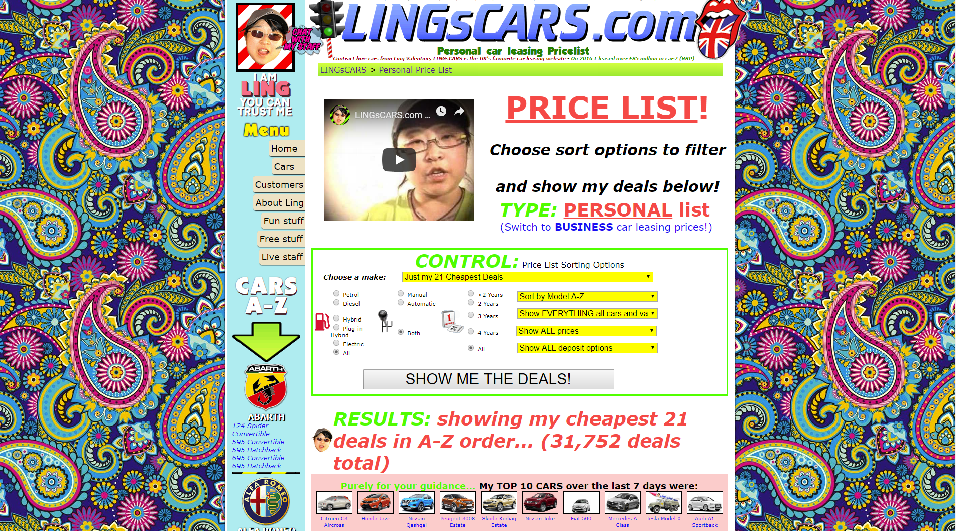
Example
https://www.lingscars.com

Slide 76
Robustness
8

Slide 77
Factors affecting Robustness
Observability – how easy is it for the user to determine the internal state of the system from the interface?
Responsiveness – the rate of communication that takes place between the user and the system – how long does it take the system to respond to a request from the user?

Slide 78
Factors affecting Robustness
Recoverability – enables the user to take corrective action once an error is detected, for example, the undo button
Conformity – does the system support all the tasks the user wants to do and does it support them when the user requests?

Slide 79
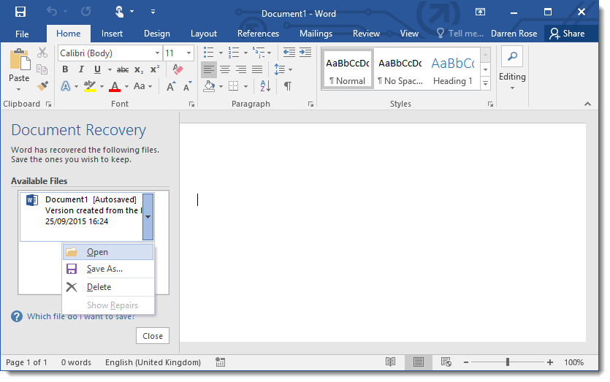
Example
Source: http://www.pcassistonline.co.uk/HelpandAdvice/document-recovery-word-2016.htm

Slide 80
MEMORABILITY
6

Slide 81
Factors affecting Memorability
Exceeding user/human memory load – possibly through over complicating with clutter or hiding required functionality unnecessarily
Unintelligent systems – expecting users to fulfil a series of tasks and rely on muscle memory rather than visual cues
Designing systems that are forgetful – users are unable/struggle to interact with a system after a period of non-use
Related to learnability

Slide 82
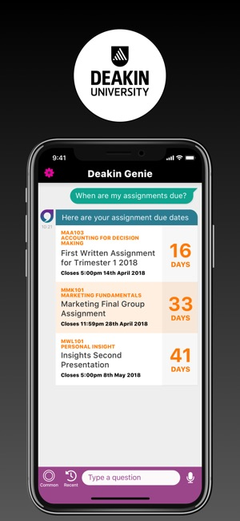
Example
Notes:
Natural commands? Intelligence
Chunking of information – related to that questions
Unit name is small – presentation of information

Slide 83
Activity – Usability Attributes
Return to the quiz on Socratives available in the ‘Deakin’ room
You have 10 minutes to complete the anonymous multiple choice quiz to test your initial understanding of the usability attributes we have just covered – learnability, efficiency, flexibility and robustness.
We will have a brief discussion on the results

Slide 84
Principles
9

Slide 85
Some basic principles….
Simple and natural dialogue
Dialogues should not contain irrelevant information. Every additional item of information competes with, and obscures the relevant stuff.
Interfaces should match the user’s task in as natural a way as possible.
Good graphic design is important to present a simple and natural interaction.

Slide 86
Some basic principles….
Speak the user’s language
The dialogue should be expressed clearly in concepts and language that the user is familiar with, instead of using technical jargon.
Follow real-world conventions, making information appear in a natural and logical order.
Ensure that the conceptual model of the system design matches the user’s mental model as closely as possible.

Slide 87
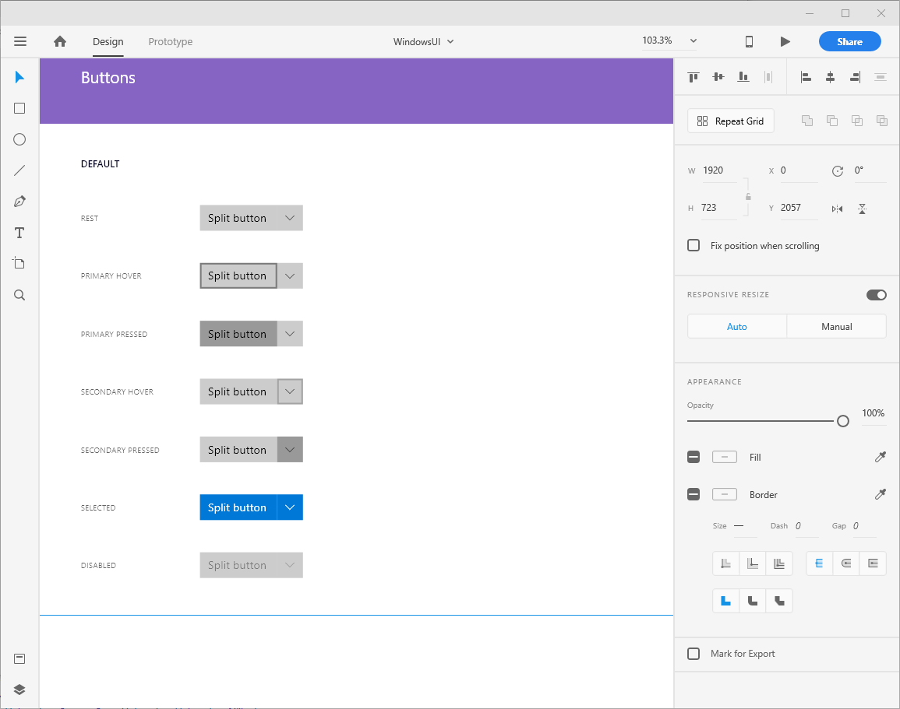
Some basic principles….
Notes:
Window UI kit
How to customise and edit
Look at words and icons, way's it presented (laid out)
Design affordances expected – across other image applications – use of icons
Clean looking, initially looks simple but can be powerful

Slide 88
Some basic principles….
Minimise user memory load
Use recognition rather than recall by keeping all objects, actions and options visible.
Users should not have to remember information between parts of the same dialogue.
Instructions for using the system should be visible or easily retrievable whenever appropriate.

Slide 89
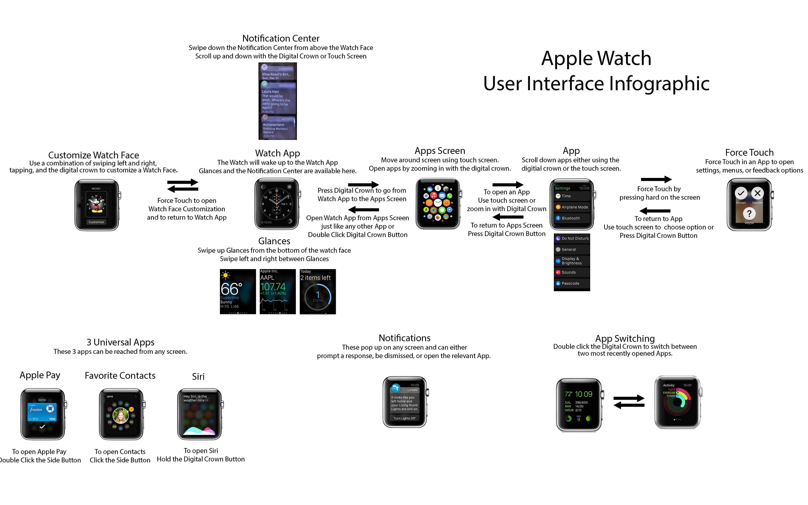
Some basic principles….
Notes:
http://i.imgur.com/FnNZzUG.jpg

Slide 90
Some basic principles….
Notes:
http://i.imgur.com/FnNZzUG.jpg

Slide 91
Some basic principles….
Notes:
http://i.imgur.com/FnNZzUG.jpg

Slide 92
Some basic principles….
Notes:
http://i.imgur.com/FnNZzUG.jpg

Slide 93

Some basic principles….
Notes:
http://i.imgur.com/FnNZzUG.jpg

Slide 94
Some basic principles….
Consistency
Users should not have to determine whether different objects and actions mean the same thing.
Users feel more confident in exploring the system if they know that the same command or action will always have the same effect.
Follow platform conventions.

Slide 95
Some basic principles….
Feedback
The system should inform users of what is happening via appropriate feedback.
Clearly marked exits
If a user selects an unwanted function/object by mistake, a clearly marked exit point should be available without having to go through extended dialogue and/or action.
Undo and redo should be supported.

Slide 96
Some basic principles….
Shortcuts
Provide accelerators to allow expert users to speed up interaction.
The system should cater for both novice and experienced users.
Allow users to customise frequently accessed options.

Slide 97
Some basic principles….
Prevent errors
Design carefully to prevent problems occurring in the first place!
Provide help features and documentation.
A system should be used without the need for documentation, however if required, help and documentation should be; easy to search, focused on the user’s task, list concrete steps to be carried out, and not too BIG.

Slide 98
Some basic principles….
Error messages
Error messages should be in clear language and avoid obscure code/“geek speak”.
Error messages should be precise, not vague or general.
Error messages should offer constructive assistance to solve the problem.
Error messages should not intimidate or explicitly blame the user.

Slide 99
Some basic principles….
Using modes
What do modes mean?
What happens in an interface that provides a user with a choice of modes?
How can we design to cater for multiple modes?

Slide 100
Some basic principles….
Other readings:
101 Things I Learned in Interaction Design School http://www.ixd101.com/
Language of Interaction (Bill DeRouchey) http://www.slideshare.net/billder/language-of-interaction-idea08-presentation

Slide 101
Activity – Usability Principles
Return to the quiz on Socratives available in the ‘Deakin’ room
You have 15 minutes to complete the anonymous multiple choice quiz to test your initial understanding of the usability principles we have just covered – simple natural dialogue, speak the user’s language, minimise user memory load, consistency, feedback, clearly marked exits, shortcuts, prevent errors, error messages and modes
We will have a brief discussion on the results

Slide 102
Summary
Interaction design should allow users to fulfill their goals using systems that keep them well-informed.
The evolution of interaction paradigms have enabled today’s touch/gesture-based systems.
Interaction is a dialogue between you and the system.
Interaction styles can take on many appearances such as menus, forms, and Q&A.

Slide 103
Summary (cont.)
Usable interfaces require a good conceptual model, visible UI elements, natural mapping, and provide feedback.
Interfaces can be deemed “more usable” if the factors that are associated with the design attributes are considered.
Usability principles are extensive. Their intention is to allow a successful dialogue between you and the interface (system).

Slide 104
Next topic...
Interface design principles and characteristics

